Slide 1
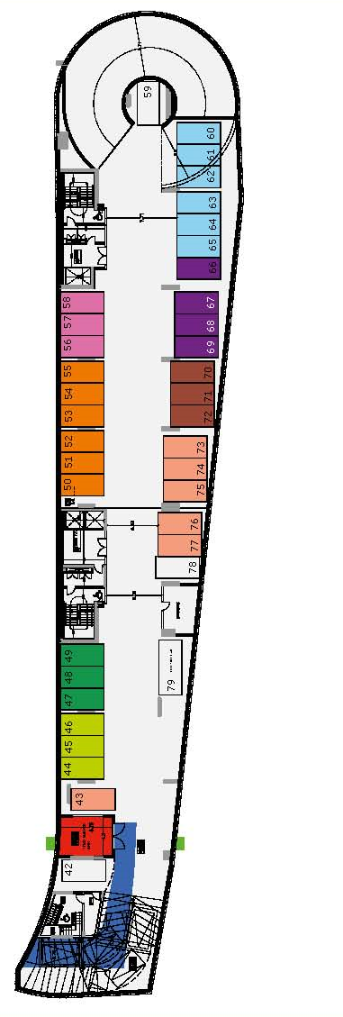
BASEMENENT LEVEL -1
Total covered area 1705 m2

Slide 2
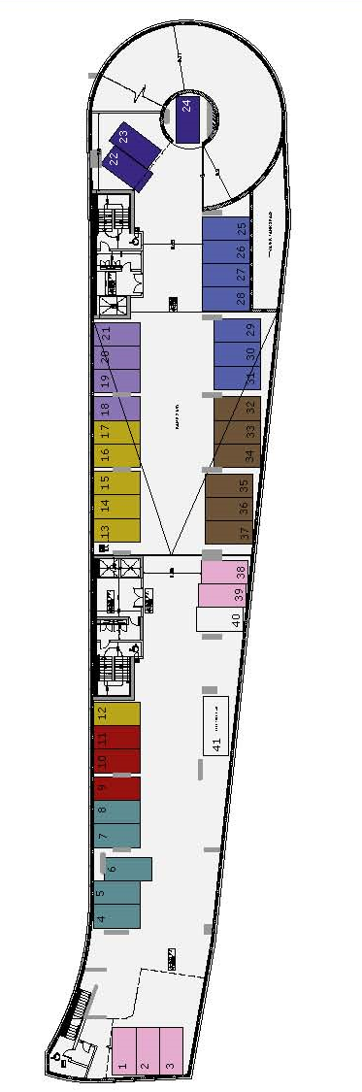
BASEMENENT LEVEL -2
Total covered area 1686 m2

Slide 3
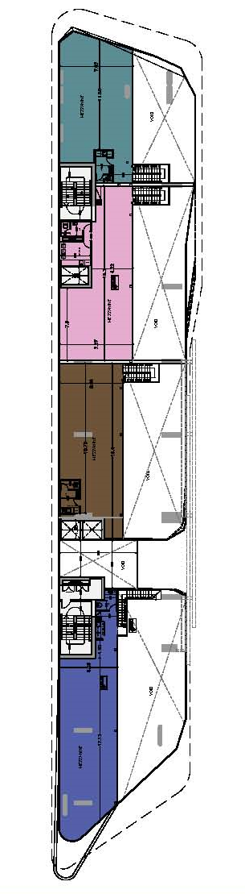
SHOPS FLOOR
Shop 1
Covered area 265 m2
Covered veranda/mezzanine 128m2
Total covered 393 m2
Covered parking 7
Shop 2
Covered area 233 m2
Covered veranda/mezzanine 116m2
Total covered 349 m2
Covered parking 6
Shop 3
Covered area 212 m2
Covered veranda/mezzanine 106m2
Total covered 318m2
Covered parking 5

Slide 4
Shop 4
Covered area 189 m2
Covered veranda/mezzanine 111 m2
Total covered 300 m2
Covered parking 5

Slide 5
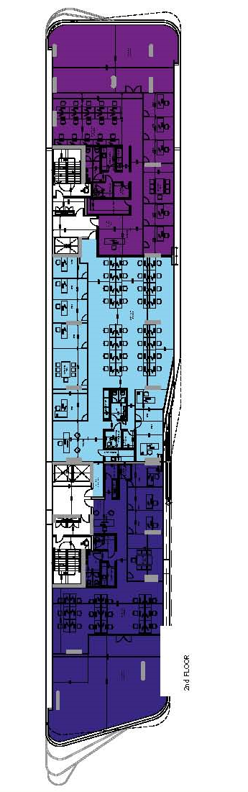
TYPICAL OFFICE FLOOR 1-4
OFFICE 201
Covered area 204 m2
Covered veranda/mezzanine 126 m2
Total covered 330 m2
Covered parking 3
OFFICE 401
Covered area 204 m2
Covered veranda/mezzanine 124 m2
Total covered 328 m2
Roof garden 323 m2
Covered parking 3

